Slide 1
WELCOME TO MIGHTY OAKS!

Slide 2
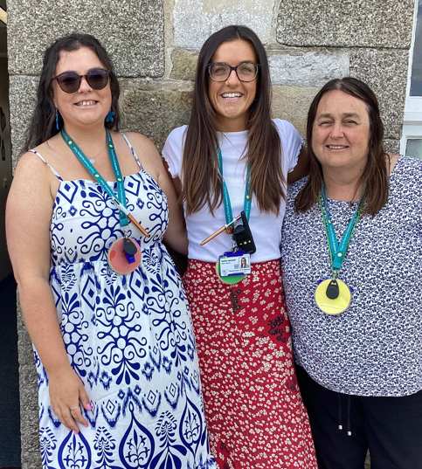
OUR TEAM
Miss Budge, Miss Laskowski + Mrs Pollard

Slide 3
PE DAYS THIS TERM
MONDAY - NETBALL
TUESDAY – TAG RUGBY
Please can children wear their PE kit to school on these days, with their school jumper over the top.
Trainers must be appropriate.

Slide 4
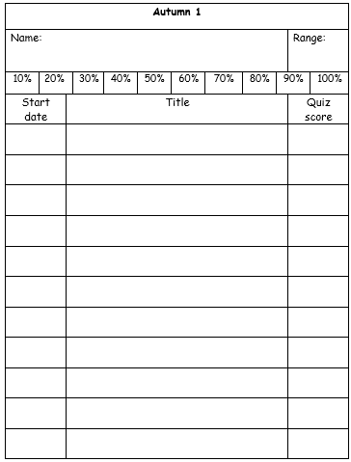
READING
Children should read at home for at least 25 minutes daily (building up to 30 minutes towards the end of the year) as part of their homework. Children on AR will be able to quiz and change their books at least 2 times per week.
ACCELERATED READER
The children take a star reader assessment every half term to allow us to keep track of their reading growth. The children are then given a band range that fits to their reading and comprehension skills. However, we also marry this with teacher judgement and sometimes we will be flexible according to each individual child’s need.
The love of reading is most important. Please encourage your child to read every night - on their own, to you, to a sibling or pet…whatever gets them reading as much as possible!

Slide 5
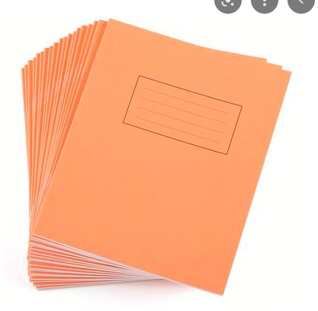

SPELLINGS
Our spellings are set on Monday, and the test will be on Friday.
Activities linked to the weekly spellings will be set on Spelling Shed each week for children to access from home.
This is part of the Year 6 homework, so please try your best to learn these at home as many times as you can.

Slide 6
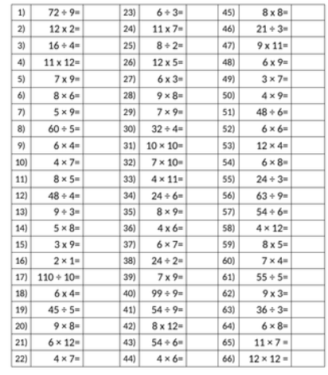

Maths Fluency
99 Club
Each Friday the children will have a go at the 99 club, which is a good way of helping them become fluent with number skills.
Times-table rock stars
TTRockstars is also part of our home learning and we ask that children log in at home and play for 10 minutes at least once or twice a week. Teachers will monitor each child's time played, current level and correct answers. Certificates will be printed weekly for achievements in these maths games.

Slide 7
Y6 Maths and SPAG homework
Each Monday, we will set maths and SPAG homework for the children from a SATS practice booklet. This should be handed in on the following Monday.
If your child requires any help, I am always happy to do so. However, it is best that they come and see me at the beginning of the week so that I can make sure I give them the time they need.

Slide 8
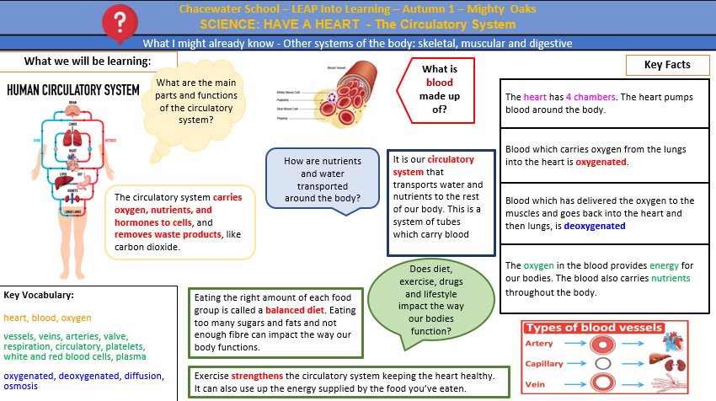
KNOWLEDGE ORGANISER
These can be found on the Mighty Oaks page on the school website.
The children will have a knowledge organiser to highlight key information for their main themes – Science, History and Geography.

Slide 9
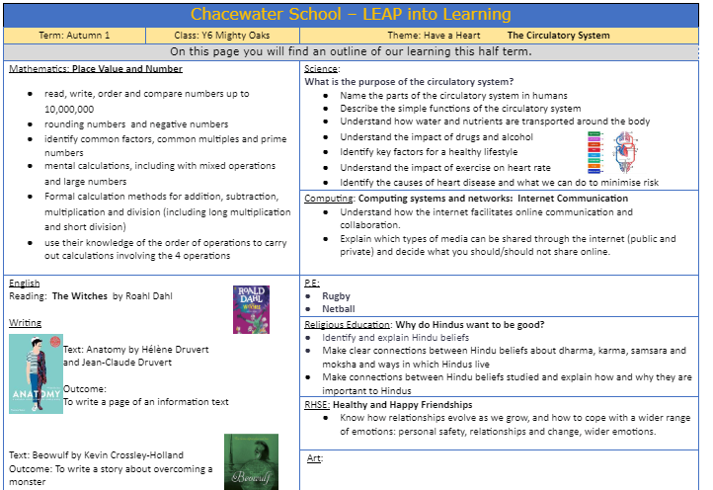
LEAP FOR LEARNING
These can be found on the Mighty Oaks page on the school website.
This breaks down the key teaching points that we will be covering this half term in all subjects.

Slide 10
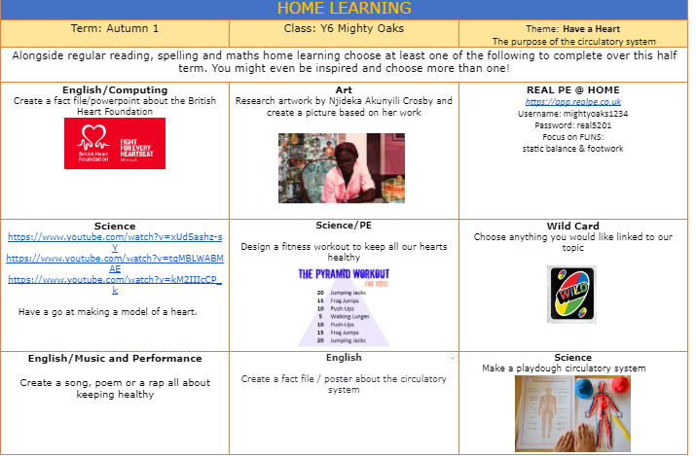
This is the voluntary homework page, where I have suggested some homework ideas to allow them to continue their learning at home.

Slide 11
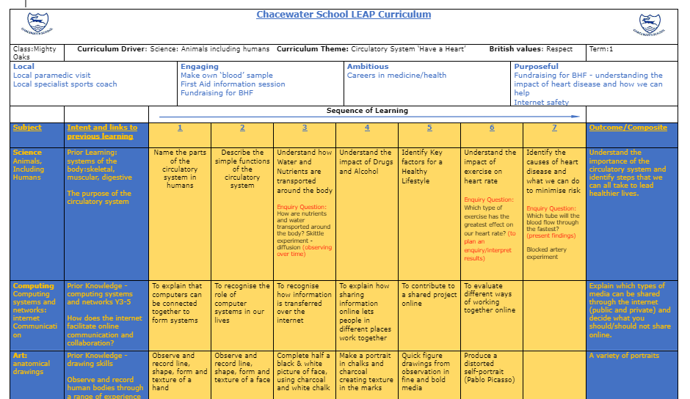
SEQUENCING DOCUMENT
These can be found on the Mighty Oaks page on the school website.
This is a break down of the main lesson objectives for each subject.

Slide 12
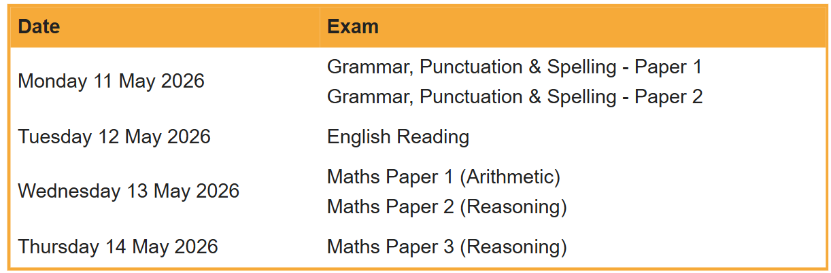
SATs week

Slide 13
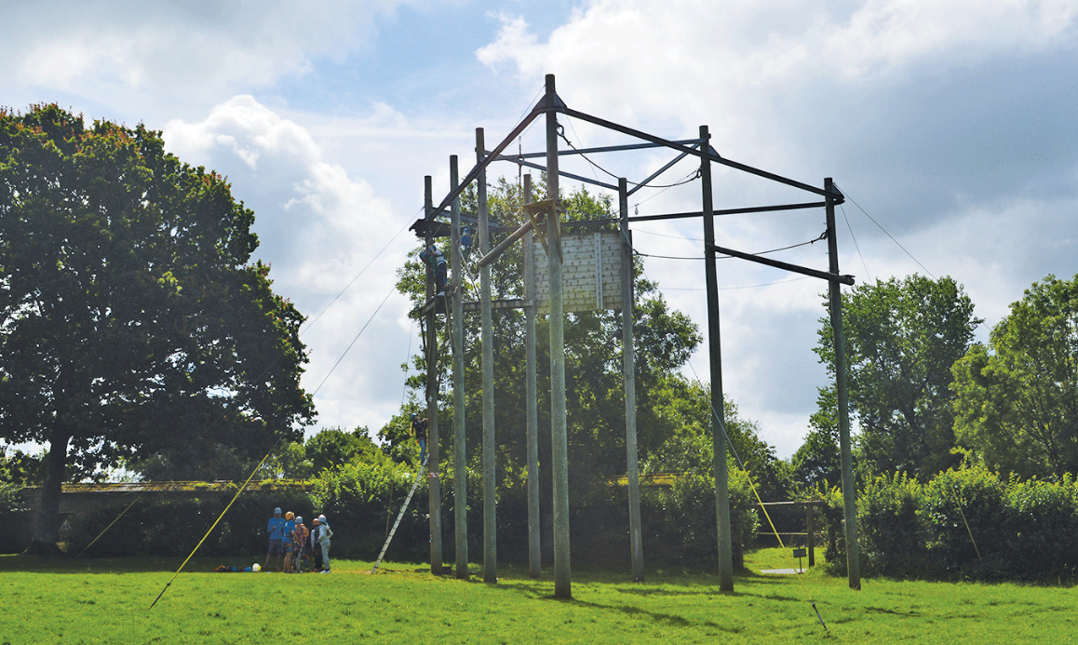
School camp
Details to come out before Christmas!
Provisional dates – June 17th – 19th

Slide 14
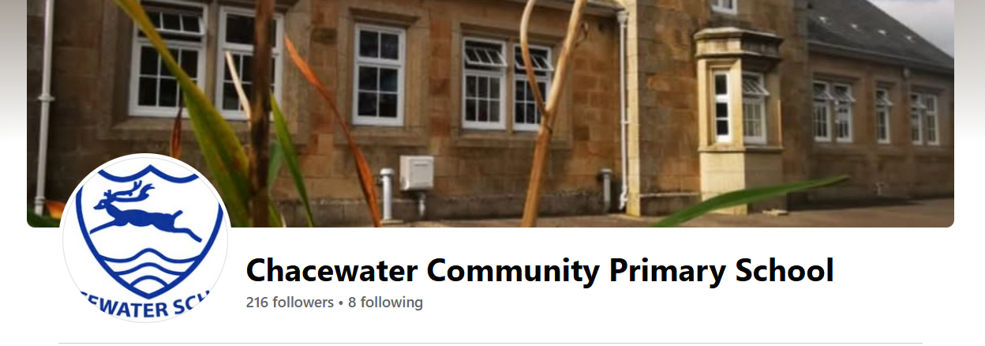
EMAIL
COMMUNICATION
A gentle reminder that children need to bring a healthy snack (fruit or vegetables for morning break).
Newsletter
chacewater@tpacademytrust.org
The school newsletter will let you know of any upcoming events and important information that you need to know.
Facebook page
On the door
I am on the door in the mornings and afternoons.
I am always happy to arrange time after school if you would prefer to talk then.

Slide 15
ANY QUESTIONS?

