Slide 1
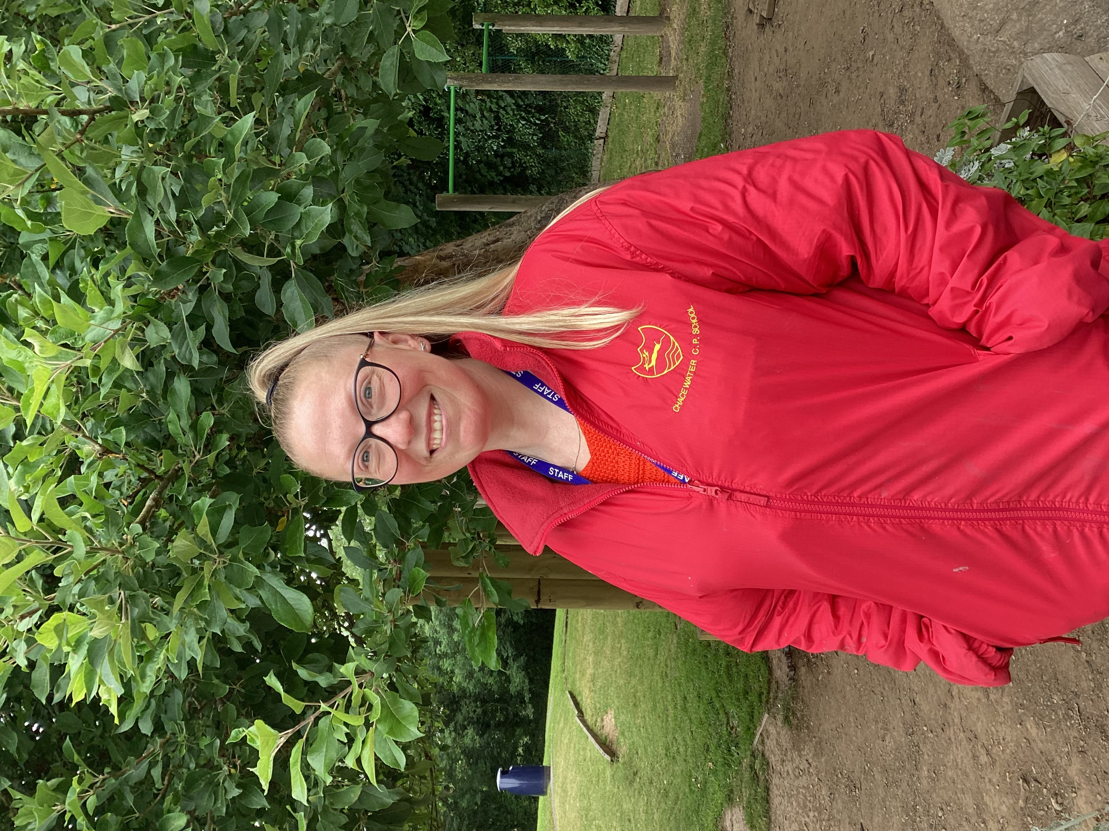
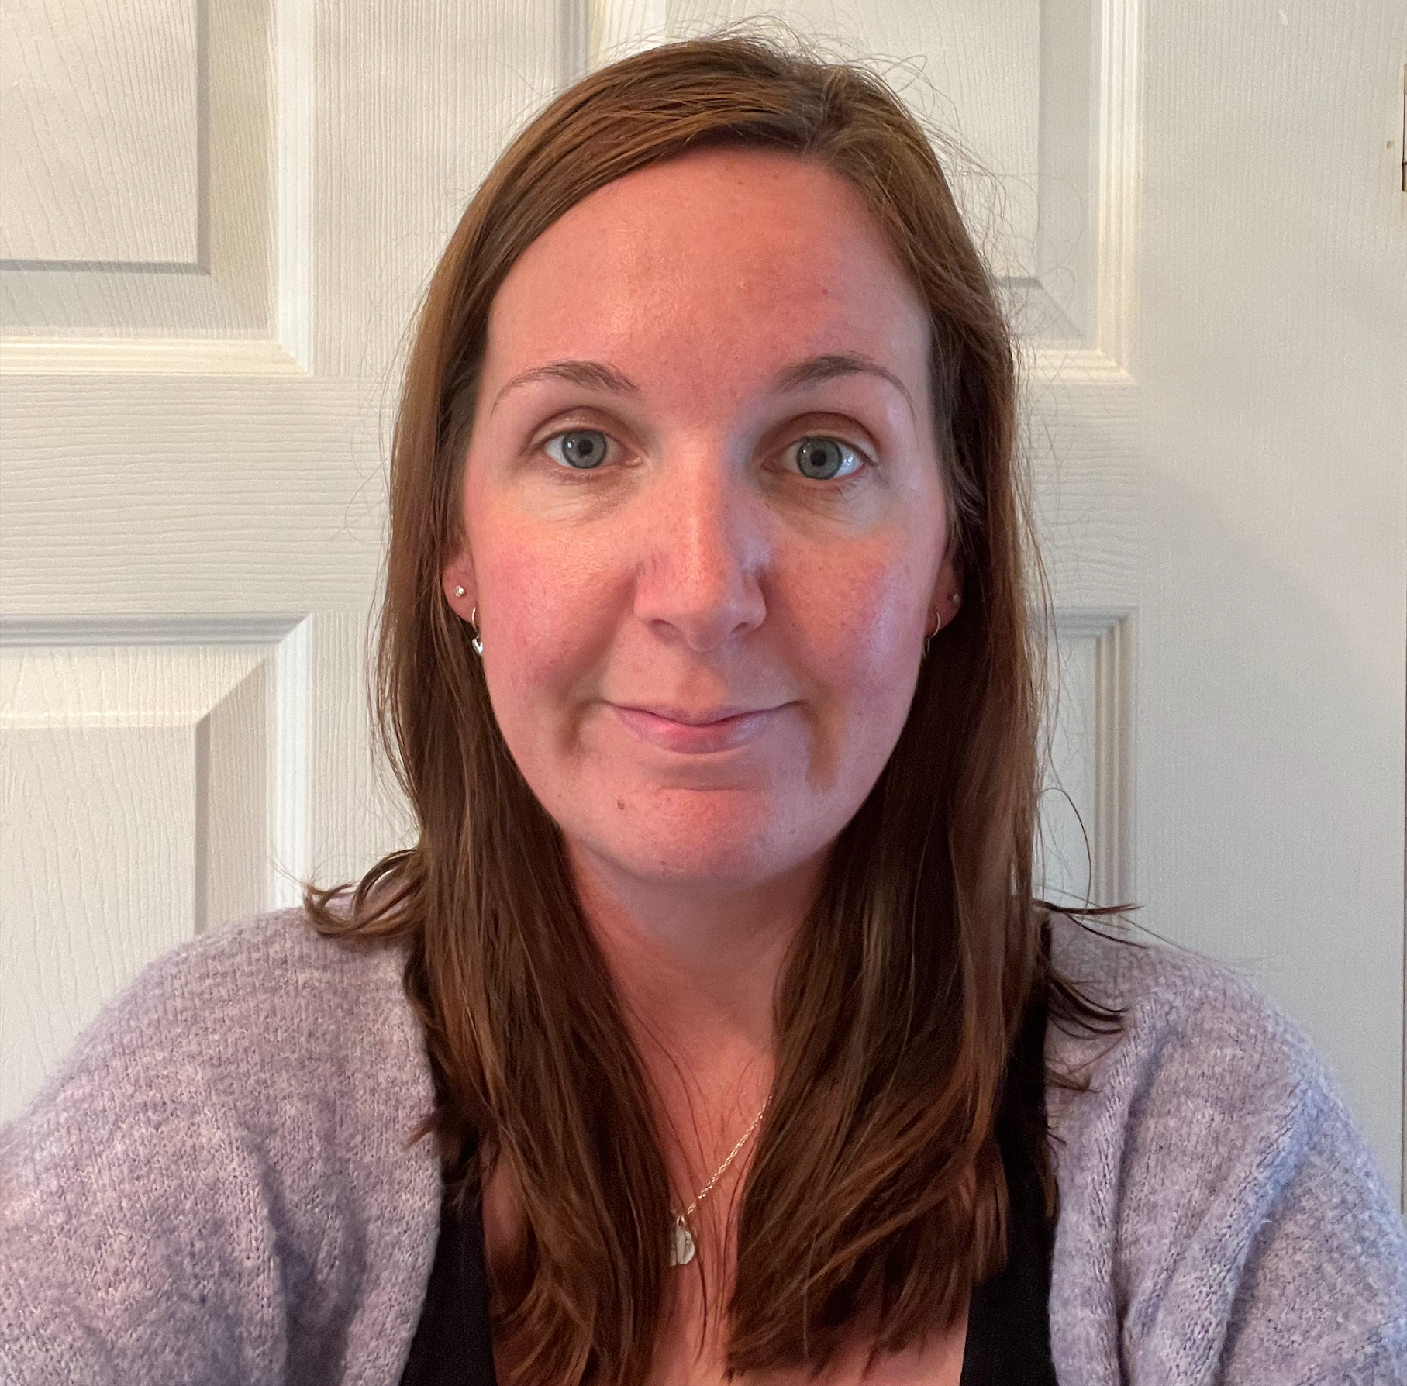
Welcome to Seedlings Class!
2024 - 2025
Miss Halford
Teaching Assistant
Miss Almey
Teaching Assistant AM
Miss Barnes
Class Teacher
Mrs Pitt will be delivering 1:1 additional interventions across KS1. Mrs Hoadley and Mrs Davis will be teaching Music and RHE on a Thursday afternoon.

Slide 2
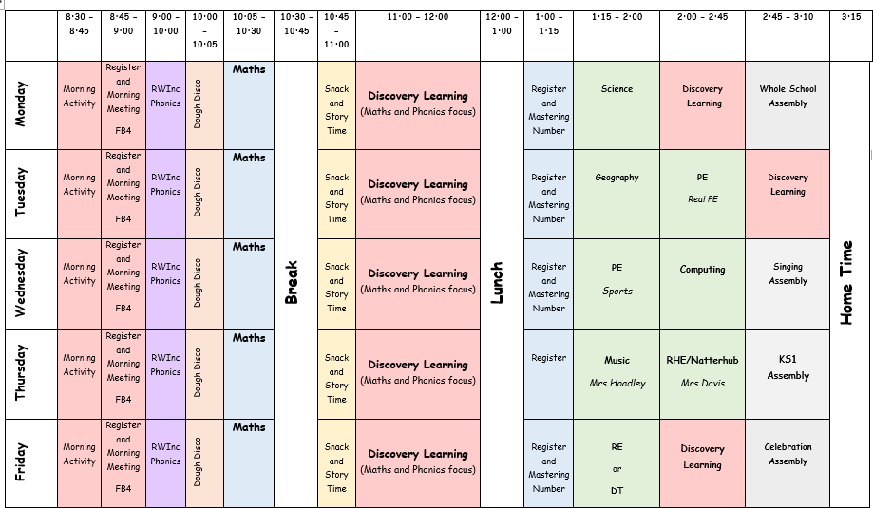
Our Weekly Timetable Autumn 1

Slide 6
Books sent home.
Every week:
A library book – promoting reading for pleasure. We change this every Monday.
Phonics books- a phonetically decodable book which link to the phonics sounds your child is covering at school. You will receive a ‘bookbag’ book on Monday and a phonics book on Wednesday. They will have been reading their phonics book in school throughout the week.
Please read with your child for at least 5 minutes every night and sign their reading diary. Please ensure your child brings in their book bag, reading books and reading records into school every day so that adults in school can support them with their reading.

Slide 7
General information in Seedlings
PE days – Tuesday and Wednesday. Please come to school in PE kit on these days.
Class email
seedlings@chacewater.tpacademytrust.org
Please check our class chalkboard (outside the door) for updates / key dates / upcoming events.
Additional overviews of learning are on our Seedlings class page on the website.

