Slide 1

WELCOME TO Seedlings!

Slide 2
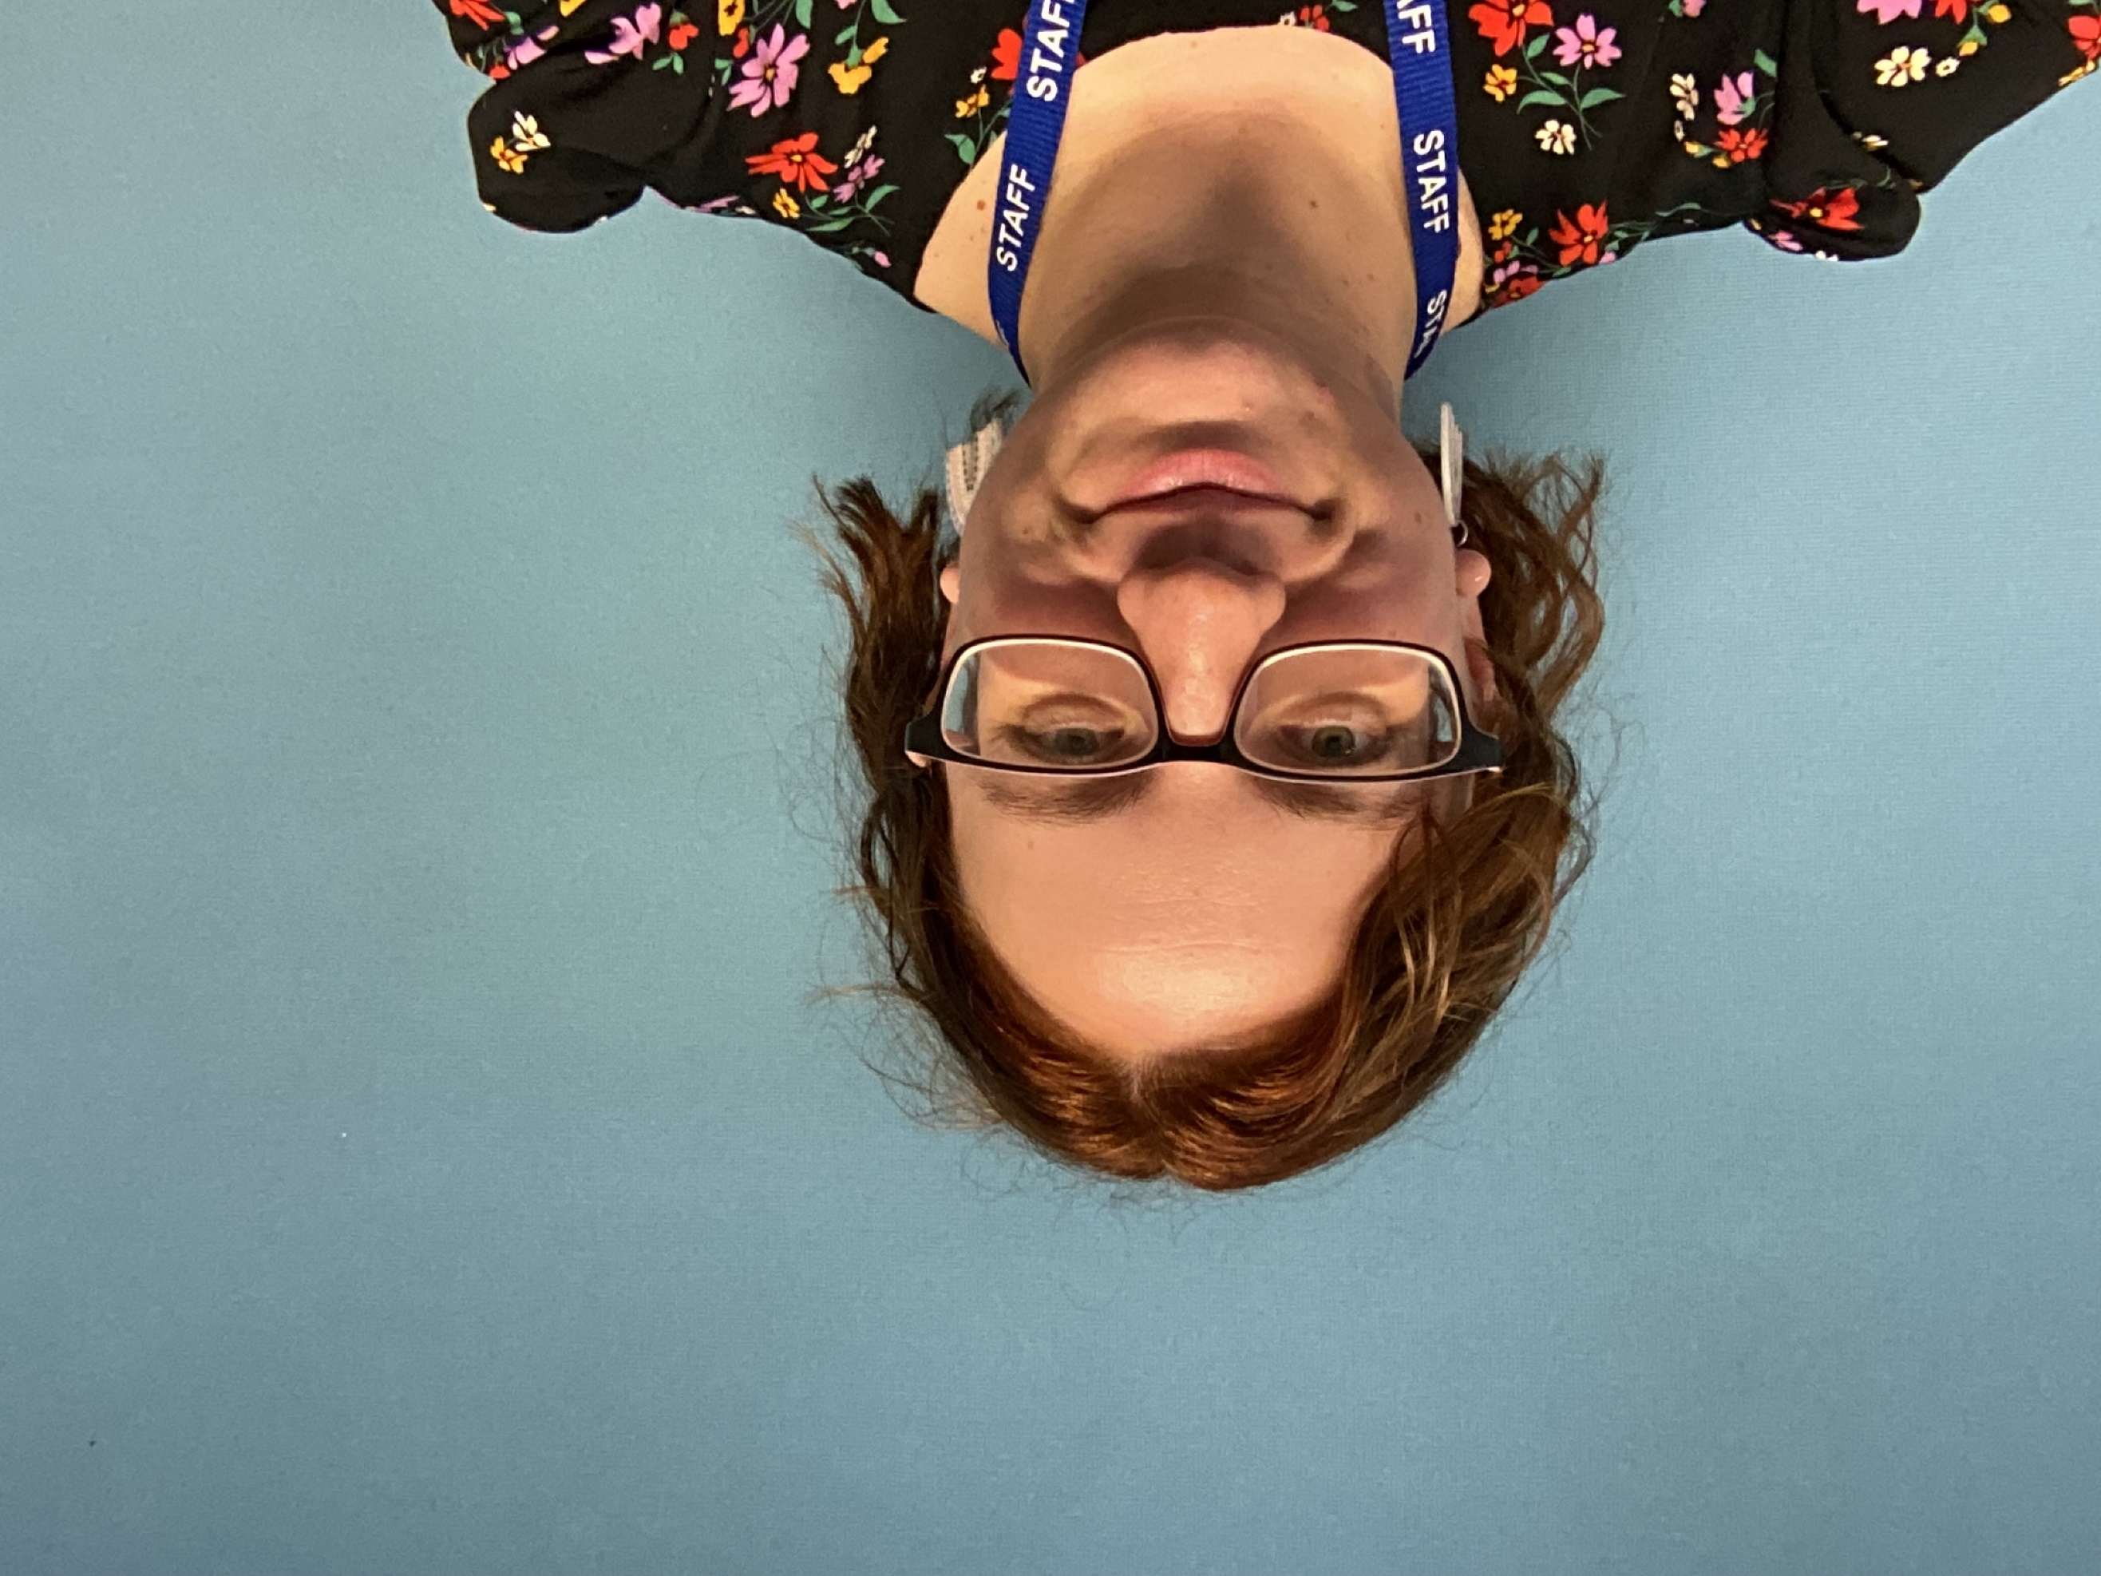
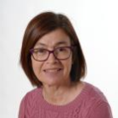
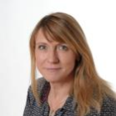
OUR TEAM
Mrs Pippin
Teaching Assistant AM
Mrs Davis
Teaching Assistant PM
Miss Barnes
Class Teacher
Mrs Hoadley will be delivering Music on Thursday afternoons, alongside DT coaching for PE.
Miss O’Callaghan will be teaching PE on Wednesday afternoons.

Slide 3
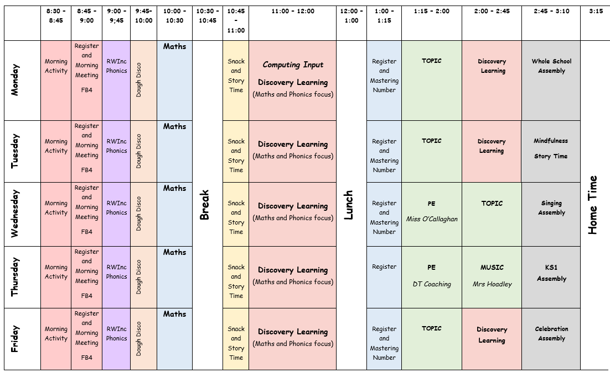
OUR DAY

Slide 4

PE DAYS THIS TERM
Wednesday
Miss O’Callaghan
Thursday
DT Coaching
Please can children wear their PE kit to school on these days, with their school jumper over the top. Footwear needs to be appropriate. Long hair needs to be tied back, earrings covered and no watches.

Slide 5

Things to remember each day :
A coat
A water bottle with water, not squash
Reading wallet with reading journal
and books inside

Slide 6
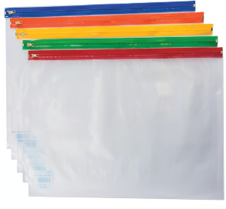
READING
These are their new reading wallets
These will have their reading records, library book and phonics books in them. Please ensure children bring in their reading wallet with all of the reading books every day. This will enable adults in school to best support your child with their reading.
Please encourage your child to read every night, and sign their reading record. A simple signature is enough, but if you would like to add a comment about your child’s reading then that would also be amazing.

Slide 7
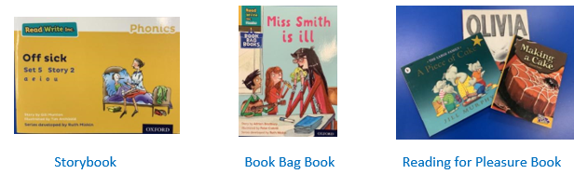
Every Monday, they will bring home a library book of their choosing, to be enjoyed with you. They may not be able to read this themselves, so you can read this to them to promote reading for enjoyment.
Every Monday, they will also bring home a book bag book. This will be linked with the story they are reading in phonics lessons, and they will be able to decode this book, although they may need some support from you.
Every Wednesday, they will bring home their storybook. They will have already been reading this book during their phonics lessons, and so should be confident reading them to you.

Slide 8

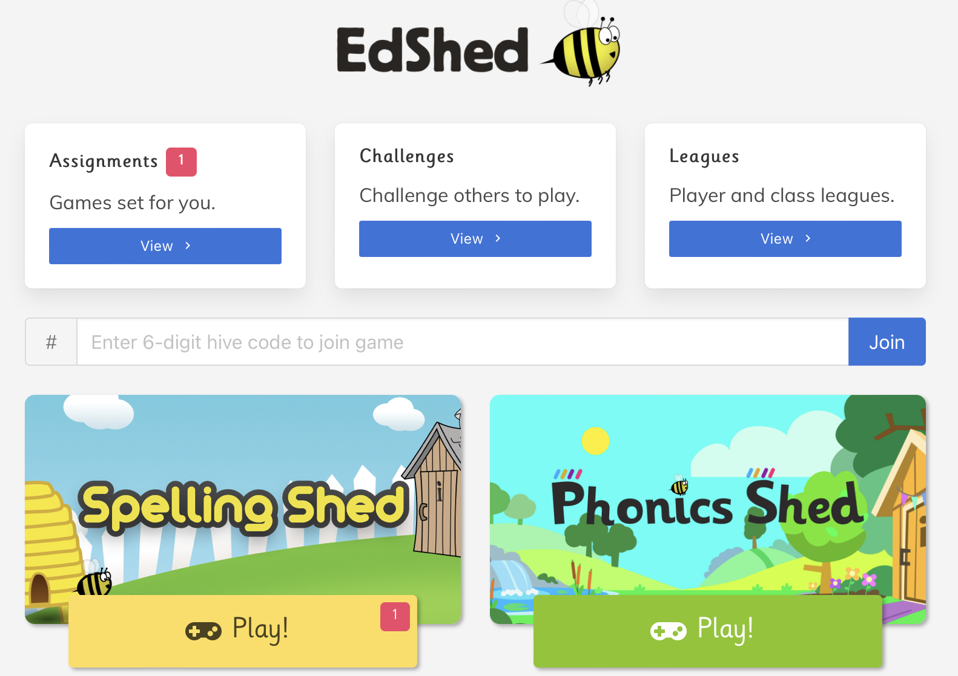
SPELLINGS - Autumn 2
Our spellings are set on a Monday, and the quiz will be on a Friday.

Slide 9

Maths Fluency
Short sessions will allow children to continue to work on their maths fluency.

Slide 10
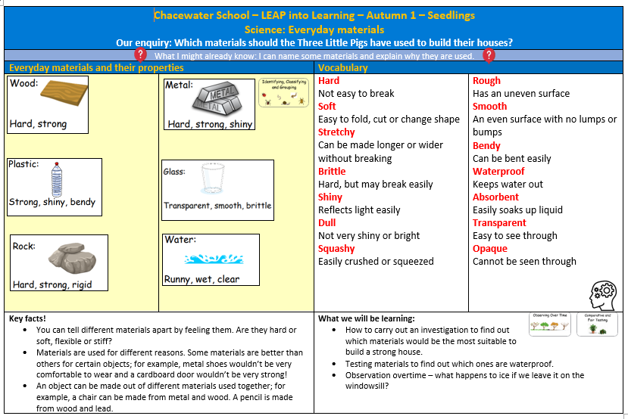
KNOWLEDGE ORGANISER
These can be found on the Seedlings page on the school website.
The children will have a knowledge organiser to highlight key information for their main themes – Science, History and Geography.

Slide 11
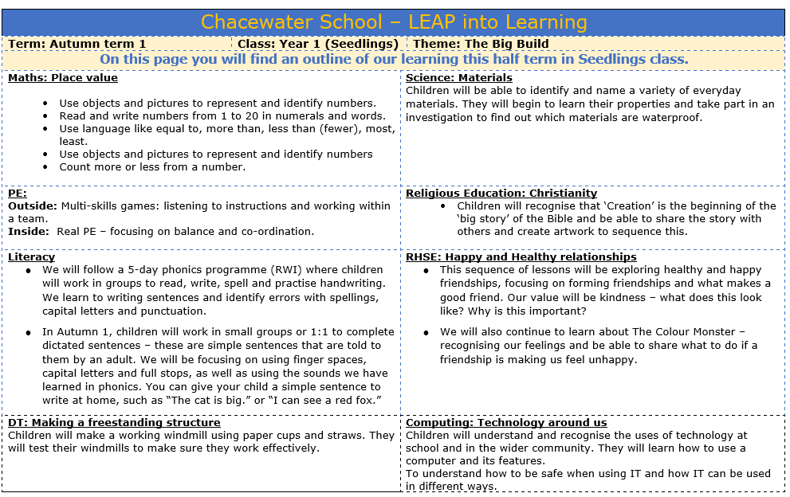
LEAP FOR LEARNING
These can be found on the Seedlings page on the school website.
This breaks down the key teaching points that we will be covering this half term in all subjects.

Slide 12

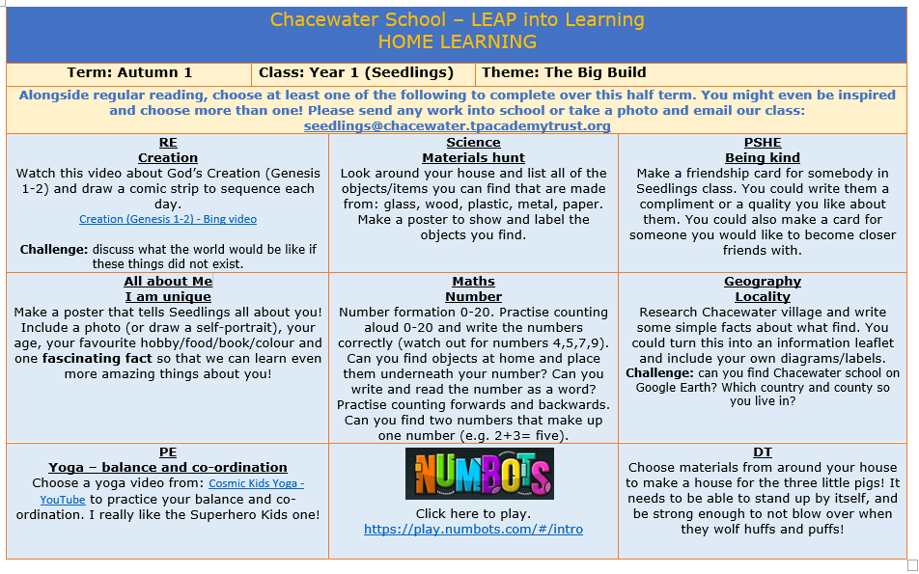
This is the voluntary homework page, where I have suggested some homework ideas to allow them to continue their learning at home.

Slide 13
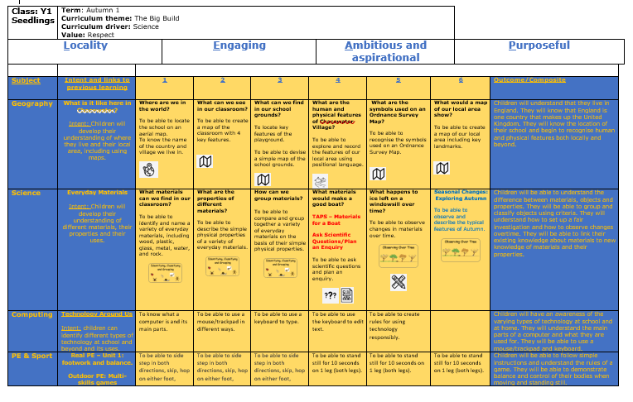
SEQUENCING DOCUMENT
These can be found on the Seedlings page on the school website.
This is a break down of the main lesson objectives for each subject.

Slide 14
EMAIL
COMMUNICATION
In KS1 snack is provided, but if you would like to pack your own healthy snack it needs to be fruit or vegetables for morning break. Thank you.
chacewater@tpacademytrust.org
Newsletter
The school newsletter will let you know of any upcoming events and important information that you need to know.
On the door/chalk board
I am on the door in the mornings and afternoons. I am always happy to arrange time after school if you have any worries or concerns.

Slide 15
ANY QUESTIONS?

