Slide 1
Welcome to the Year 5 Red Oaks
Class parent meeting

Slide 2
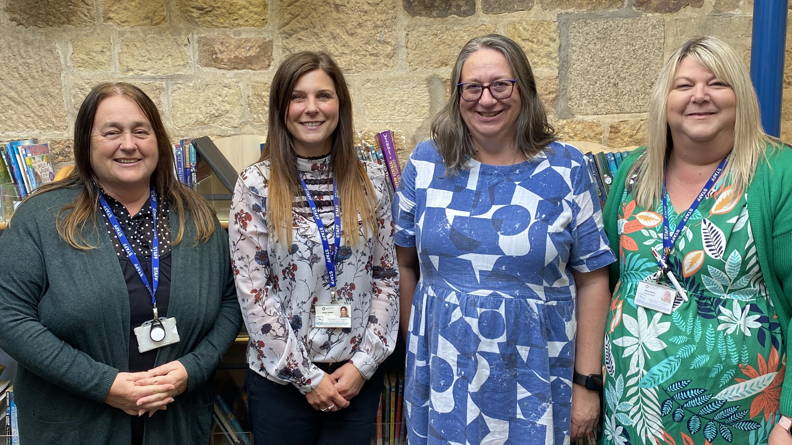
Our staff Team in Y5:
Teaching assistants :
Teachers:
Mrs. Pollard
Mrs. Dicker
Mrs. James
Mrs. Law

Slide 3
Things to remember each day :
A coat
A water bottle
A healthy snack - fruit or veg
Reading book
Reading bookmark

Slide 4
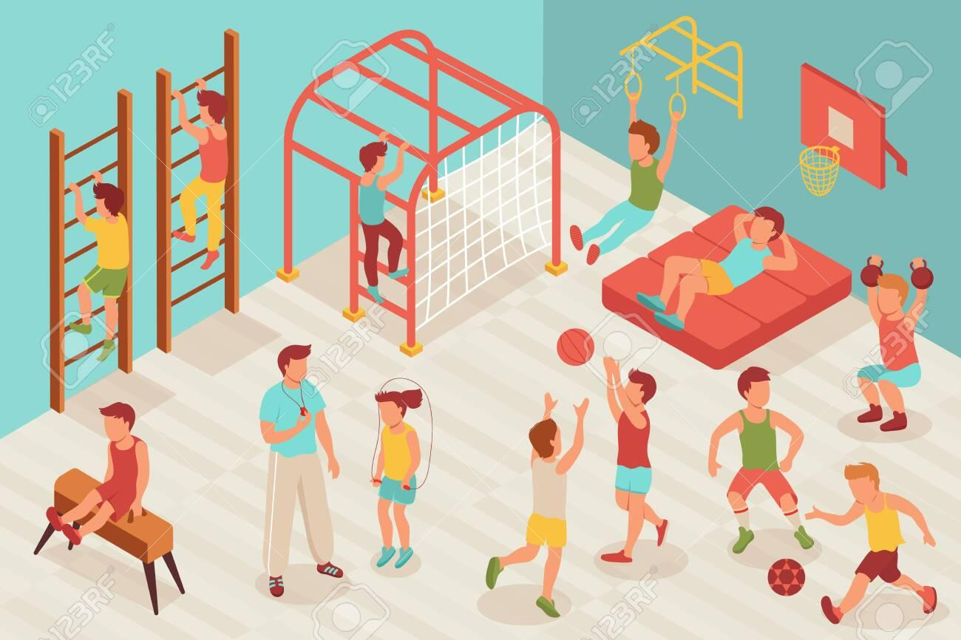
P.E DAYS THIS HALF TERM
Monday
Rugby
Friday
Netball
Mrs. James
Miss. Laskowski
Children wear their PE kit to school on these days, with their school jumper over the top. Footwear needs to be appropriate. Long hair needs to be tied back, earrings covered and no watches.

Slide 5
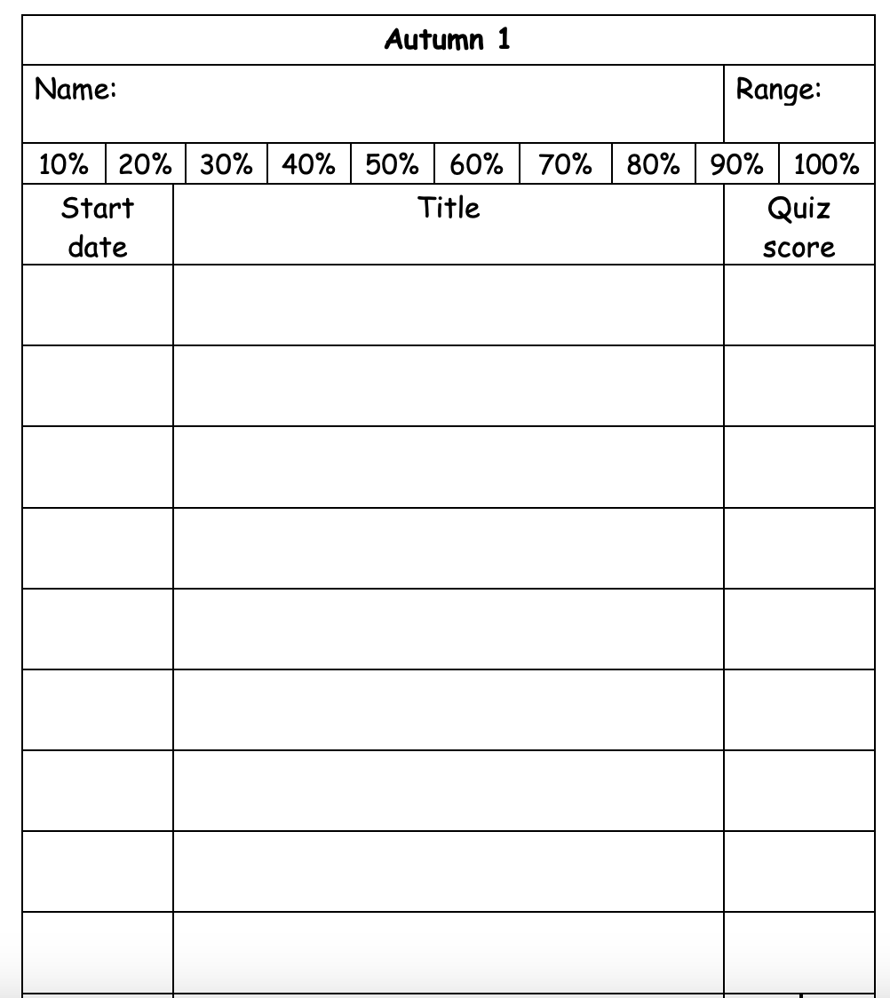
READING
Reading bookmarks need to come to school every day.
Children should read at home for 20 – 30 minutes every day as part of their homework.
Children will take a star reader assessment every half term to assess their ‘range’ – zone of proximal development.
Children quiz and change their books as needed.
Children earn points through quizzing to complete their individual reading target each half term.

Slide 6
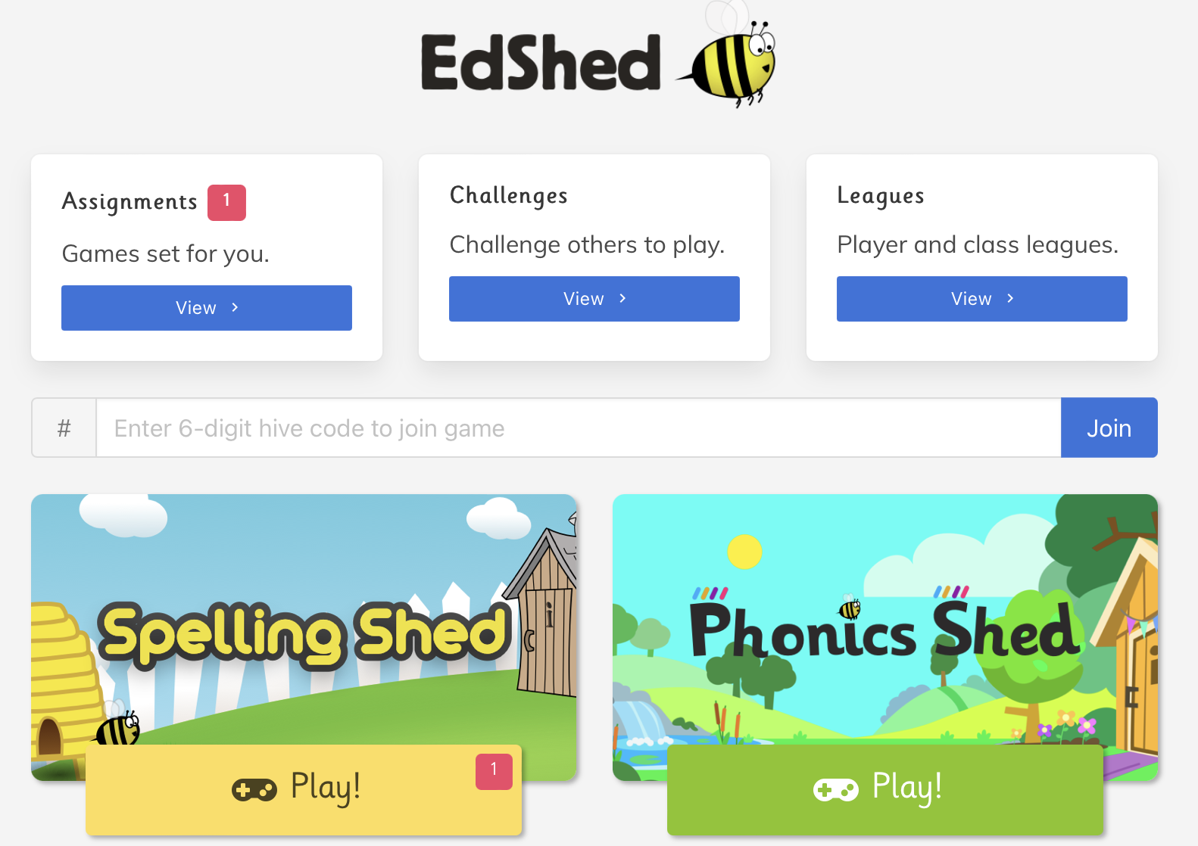
SPELLINGS
Word lists and linked activities found on Ed Shed
Our spellings are set on Friday, and the quiz will be on the following Friday.
This is part of the Year 5 homework, so please practice at home.

Slide 7
Maths Fluency
Short sessions frequently
This is part of the Year 5 homework, so please practice at home.

Slide 8
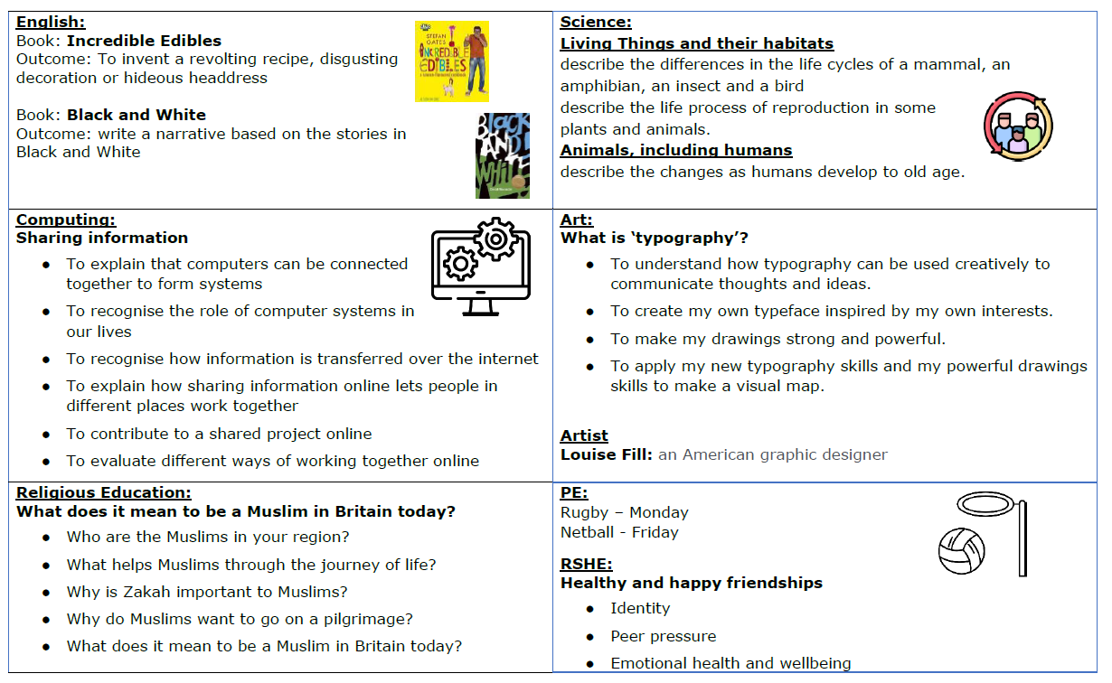
LEAP into LEARNING
This will summarise our learning for each half term

Slide 9
On the back of our Leap into learning is our home learning page, with suggested homework ideas linked to our learning this half term. Children should choose at least 1 to complete.

Slide 10
Wider curriculum : What are we learning ?
We share ‘knowledge organisers’ each half term to show our key learning in either Science, History or Geography.

Slide 11
EMAIL
COMMUNICATION
redoaks@chacewaterschool.co.uk
Please note this email is not checked daily. For urgent matters please contact the office.
Newsletter
Emailed weekly, the school newsletter will let you know of any upcoming events and important school information that you need to know.
On the door
We are always on the door in the mornings and afternoons and happy to chat if you have any worries or questions.

Slide 12
ANY QUESTIONS?

