Slide 1
KEY STAGE 1 SATS
Thursday 12TH May

Slide 2
TA judgements in English reading, English writing, mathematics and science are reported at the end of KS1. TA is based on a broad range of evidence from across the curriculum and knowledge of how a pupil has performed over time and in a variety of contexts. It is carried out as part of teaching and learning. TA is the only data used in school performance accountability at the end of KS1.
Information and Guidance on the Changes and Expectations for 2021/22

Slide 3
For pupils who have completed the KS1 programmes of study, teachers must use the TA frameworks when making their judgements. The frameworks contain 3 standards: • working towards the expected standard; • working at the expected standard; • working at greater depth within the expected standard. Pupils who are not yet ‘working towards the expected standard’ should be assessed using the pre-key stage standards. For science a pupil who has completed the programme of study will be judged as either ‘working at the expected standard’ or ‘has not met the expected standard’.

Slide 4
In 2014, a new national curriculum framework was introduced by the Government for Years 1, 3, 4 and 5. However, Years 2 and 6 (due to statutory testing) continued to study the previous curriculum for one further year. However, in 2015/2016, children in Year 2 and Year 6 were also expected to study the new national curriculum. In the summer of 2016, KS1 (Year 2) and KS2 SATs (Year 6) reflected the new curriculum for the first time.
Key Stage 1 National Curriculum Assessments

Slide 5
The SAT Assessments At the end of Year 2, children will take assessments in: Reading; Maths; Grammar, Punctuation and Spelling (this is optional for schools); Tests are marked internally. May 2022 – Test Period (Tuesday 17th May 2022 to Friday 27th May 2022). Wednesday 1st June 2022 – Raw scores to scaled scores information available (half-term). From Monday 6th June 2022, several children will also undergo Phonic Screening, if they were not at the required standard in autumn 2021. Ask if you are unsure if it is your child.

Slide 6
Scaled Scores What is meant by ‘scaled scores’? It is planned that 100 will always represent the ‘national standard’. Each pupil’s raw test score will therefore be converted into a score on the scale, either at, above or below 100. The scale will have a lower end point somewhere below 100 (85 in 2019) and an upper end point above 100 (115 in 2019). No scaled score is given for children who score 0 to 2. A child who achieves the ‘national standard’ (a score of 100) will be judged to have demonstrated sufficient knowledge in the areas assessed by the tests. If the scaled scores indicate that your child isn’t working at the expected standard, you shouldn’t worry. It’s important to remember that these test results aren’t the whole picture. Teachers use the test results as one piece of evidence to help them arrive at their overall teacher assessment judgements and help them identify what additional support your child may need.

Slide 7
On publication of the test thresholds on Wednesday 1st June 2022: A child awarded a scaled score of 100 is judged to have met the ‘national standard’ in the area judged by the test. A child awarded a scaled score of more than 100 is judged to have exceeded the national standard and demonstrated a higher than expected knowledge of the curriculum for their age. A child awarded a scaled score of less than 100 is judged to have not yet met the national standard and performed below expectation for their age. Marking guidance for KS1 tests will include conversion tables. Teachers will use these to translate pupil’s raw scores into scaled scores to see whether each pupil has met the national standard. Teachers will use the scaled scores to inform their teacher assessment judgements.

Slide 8
The Reading Test consists of two separate papers: Paper 1 – consists of a combined reading prompt and answer booklet. The paper includes a list of useful words and some practice questions for teachers to use to introduce the contexts and question types to pupils. The test takes approximately 30 minutes to complete, but is not strictly timed. This test is worth 20 marks. Paper 2 – consists of an answer booklet and a separate reading booklet. There are no practice questions on this paper. Teachers can use their discretion to stop the test early if a pupil is struggling. The test takes approximately 40 minutes to complete, but is not strictly timed. This test is worth 20 marks. The texts will cover a range of poetry, fiction and non-fiction. In 2017, 2018 and 2019, a score of 25/40 was needed to obtain a scaled score of 100.

Slide 9
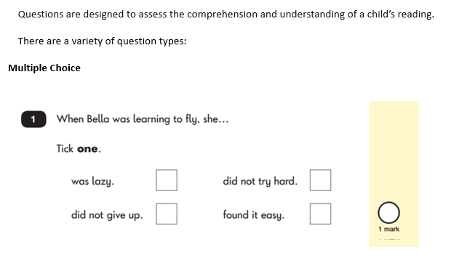
Reading: Sample Questions

Slide 10
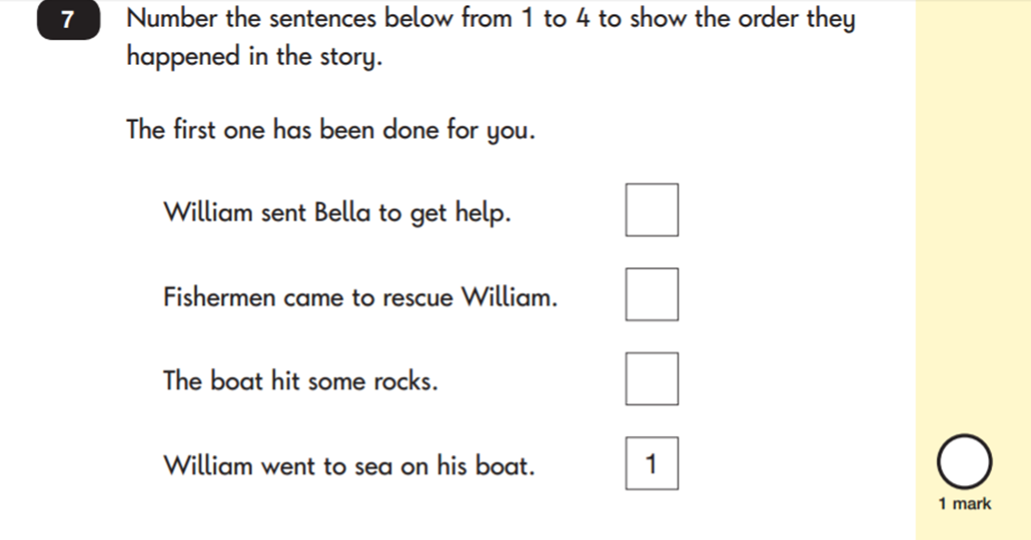
Reading: Sample Questions
Ranking/ ordering

Slide 11
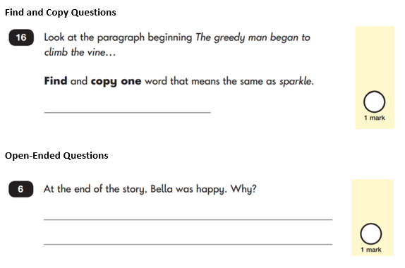
Reading: Sample Questions
Ranking/ ordering

Slide 12
This year, the Grammar, Punctuation and Spelling test will be optional for all Year 2 classes. The test consists of two separate papers: Paper 1: Spelling - pupils to spell 20 missing words within a test booklet. The test is expected to take approximately 15 minutes to complete, but is not strictly timed. This test is worth 20 marks. Paper 2: Grammar, Punctuation and Vocabulary - a combined question and answer booklet focusing on pupils’ knowledge of grammar, punctuation and vocabulary. Pupils will have approximately 20 minutes to complete the questions in the test paper, but it is not strictly timed. This test is worth 20 marks. In 2017, 2018 and 2019 a score of 24/40 was needed to obtain a scaled score of 100.
Grammar, Punctuation and Spelling

Slide 13
Children will sit two tests: Paper 1 and Paper 2: Paper 1: Arithmetic - lasts approximately 20 minutes (but this is not strictly timed). It covers calculation methods for all operations. This test is worth 25 marks. Paper 2: Reasoning - lasts for approximately 35 minutes, which includes time for five aural questions (five minutes). Pupils will still require calculation skills and questions will be varied including multiple choice, matching, true/false, completing a chart or table or drawing a shape. Some questions will also require children to show or explain their working out. This test is worth 35 marks. In 2017 and 2018, a score of 36/60 was needed to obtain a scaled score of 100. In 2019 you needed a score of 34 to obtain a scaled score of 100.
Mathematics

Slide 14
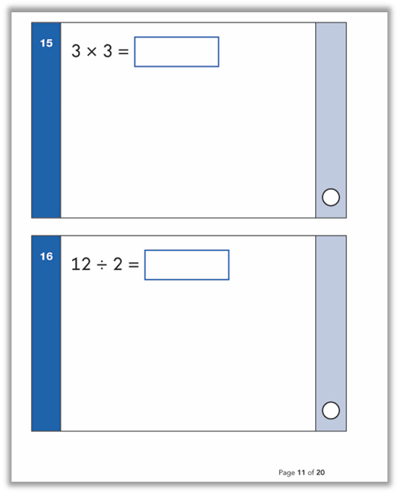
Maths Paper 1: Arithmetic
Maths Paper 2: Reasoning and problem solving

