Slide 1
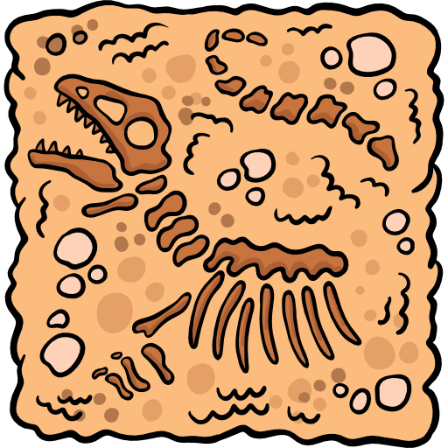
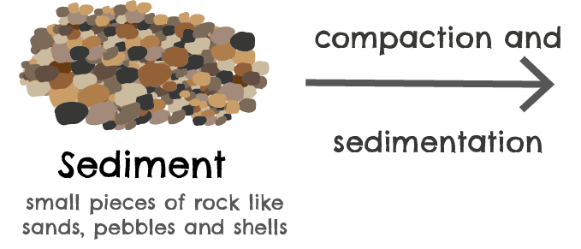
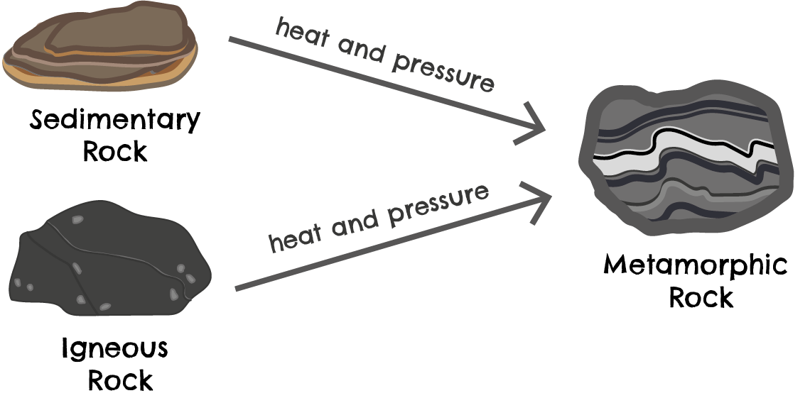
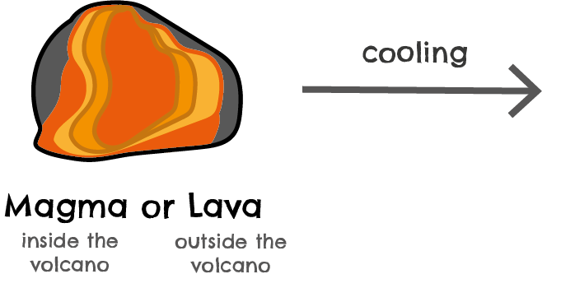
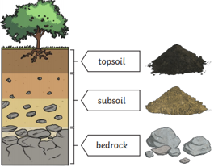
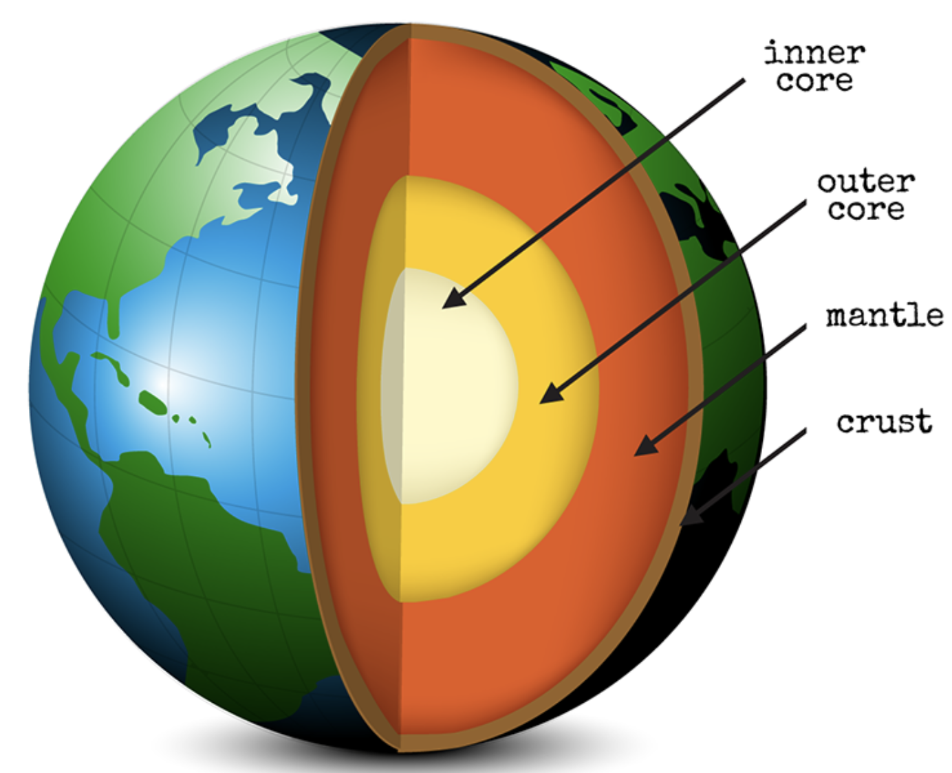
Chacewater School – LEAP Into Learning – Spring 2 – Young Oaks SCIENCE: Rocks and Fossils
What I might already know: There are different types of rock with different properties (Year 1 & 2)
KEY QUESTIONS:
There are three types of naturally occurring rock.
What do fossils tell us about changes over time?
Fossils are the remains of, or an impression left by prehistoric living things, embedded within rocks
Do rocks let water through them?
Key Vocabulary:
Organic matter
Bedrock
Magma
Pressure
Fossils
Permeable
Sedimentary
Igneous
Metamorphic.
Soil is a mixture of:
minerals, air, water and organic matter.
Rocks can be compared and grouped by their physical properties:
Sandstone is permeable and allows water to pass through.
Marble is impermeable so water cannot pass through.
The Earth

Slide 2
SCIENCE – Rocks and Fossils End of Unit Assessment
What have you learnt?
Answer the KEY QUESTIONS:
Question 1: Do rocks let water through them?
Label and match the parts of the soil below.
Question 2: How could we group rocks?
Subsoil
Bedrock
Question 3: How are fossils made?
Top Soil
What are the three main types of rocks?
What are fossils?
What are the three main types of fossils? .

