Slide 2
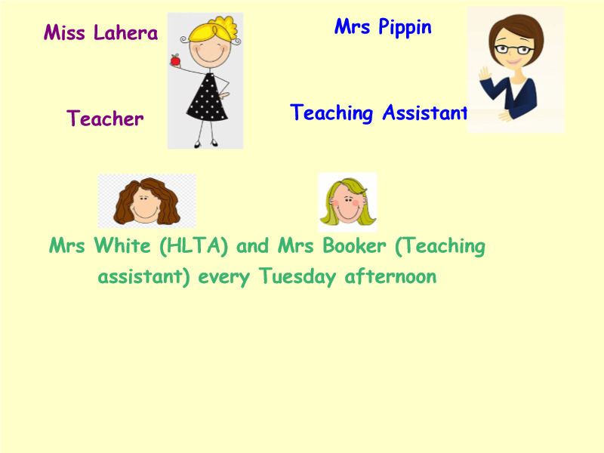

Slide 4
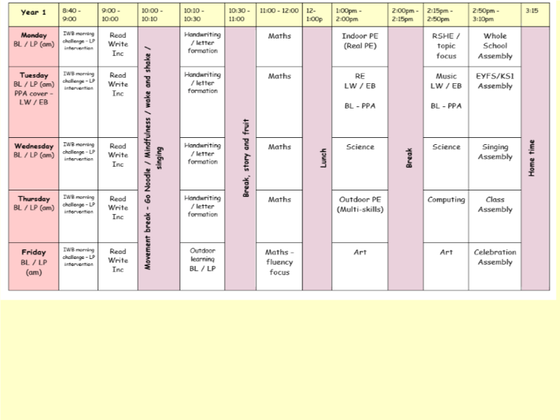
An example of our weekly timetable in Seedlings.

Slide 6
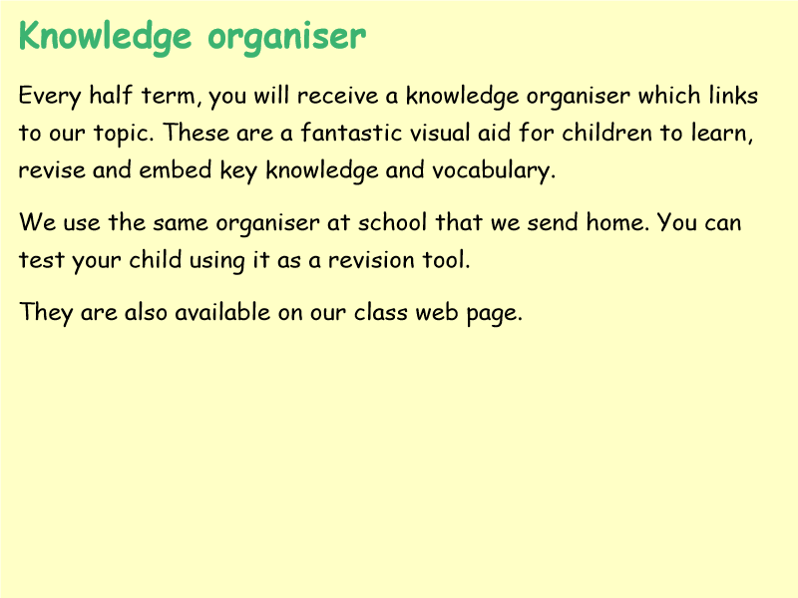

Slide 7
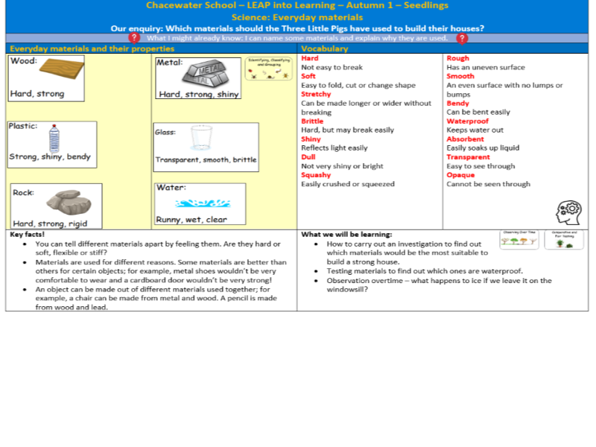
Autumn 1 – Science Knowledge Organiser is downloadable from our class page.

Slide 8
Autumn 1 – Leap into Learning (Homework) is downloadable from our class page.

Slide 9
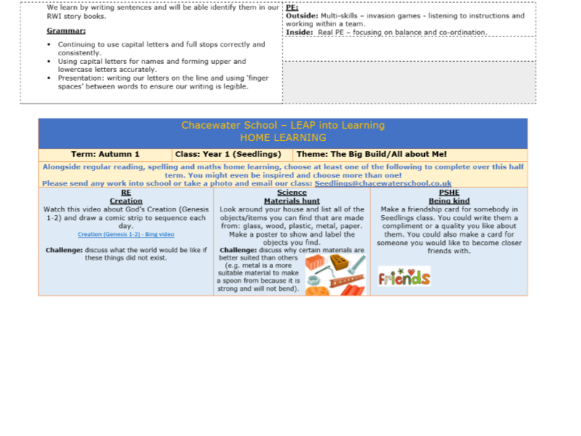
Autumn 1 – Leap into Learning (Homework) is downloadable from our class page.

Slide 10
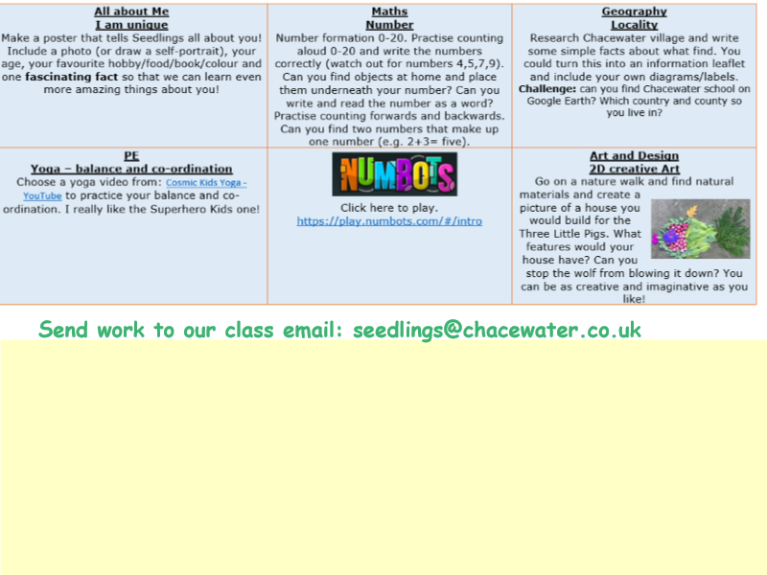
Autumn 1 – Leap into Learning (Homework) is downloadable from our class page.
There is not an expectation to complete every piece of homework set. We want to offer creative learning opportunities that fit into busy lifestyles. Homework should be fun and motivating so encourage your child to complete the above activities that inspire them at your own pace across the half term.

