Slide 1
Welcome to Seedlings Class!
2023 - 2024
Miss Almey
Teaching Assistant AM
Mrs Pitt
Teaching Assistant PM
Miss Barnes
Class Teacher
Mrs Hoadley covers music on Tuesday afternoons alongside Mr Roberts who teaches PE.

Slide 2
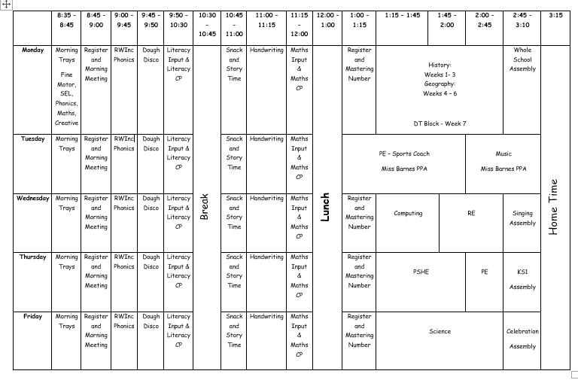
Our Weekly Timetable Autumn 1
We begin the year using continuous provision to transition the children into Key Stage 1. Throughout the year our timetable will change as the children begin to work more independently and for longer amounts of time.

Slide 3
Autumn 1 – Leap into Learning document is downloadable from our class web page.

Slide 4
LEAP into Learning homework activities.

Slide 6
Books sent home
Every week:
A library book – promoting reading for pleasure. We change this every Monday.
Phonics books- a phonetically decodable book which link to the phonics sounds your child is covering at school. You will receive a ‘bookbag’ book on Monday and a phonics book on Wednesday. They will have been reading their phonics book in school throughout the week.
Please ensure your child brings in their book bag, reading books and reading records into school every day so that adults in school can support them with their reading.

Slide 7
General information in Seedlings
PE days – Tuesday and Thursday. Please come to school in PE kit on these days.
Class email
seedlings@chacewater.tpacademytrust.org
Please check our class chalkboard (outside the door) for updates / key dates / upcoming events.
Additional overviews of learning are on our Seedlings class page on the website.

